Slide 1
Sahyadri Navigator
Group no-06
1.Meghana Bharambe
2.Supriya Sutar
3.Sumit Patil
4.Dhanshri Kshirsagar

Slide 2
AGENDA:
Project Overview
Users and Use Cases
Project Architecture
Individual Role and contribution
Project Methodology
Testing Approach
Future Extensions
Experience and Lessons learnt

Slide 3
Abstract:
The main objective of this project is building a website which will help trekkers from different places to find trekking spot.
Trekkers can find best suitable option from multiple trekking clubs which have registered on our platform.
They can go through multiple options and according to their preferences (time, place, price and other facilities) they can select suitable choice.
Different Trekkers club can register on our platform and can put their next schedule about their trekking events.

Slide 4
Project Architecture
FRONT END
MIDDLE TIER WITH MICROSERVICES ARCHITECTURE
DATABASE TIER
Web Server running on localhost : 3000
.NET Rest API Server on localhost : 7142
Entity Framework
MySQL
Spring boot Rest API Server running on localhost : 8080
HTML,CSS
BOOTSTRAP
REACT JS Components
JPA
Running on 3306

Slide 5
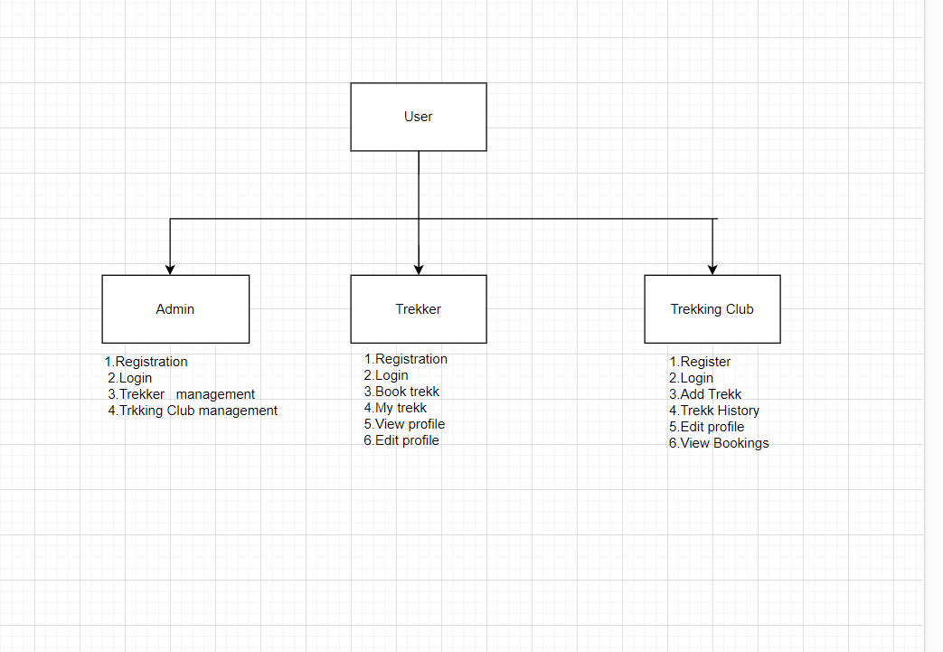
Use Case Diagram:

Slide 6
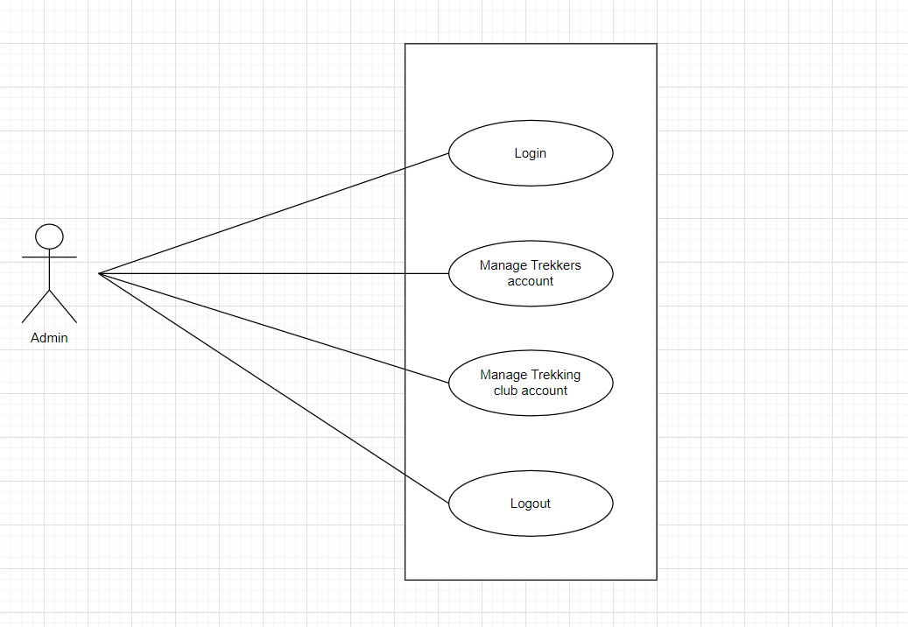
Admin Work FLow:
Sahyadri Navigator should provide all function to admin how to handle the System.
Admin will Manage the Trekker (Delete).
Admin will Manage the Trekking Club (Approve, Delete)
Could able to know all the Transaction.

Slide 7
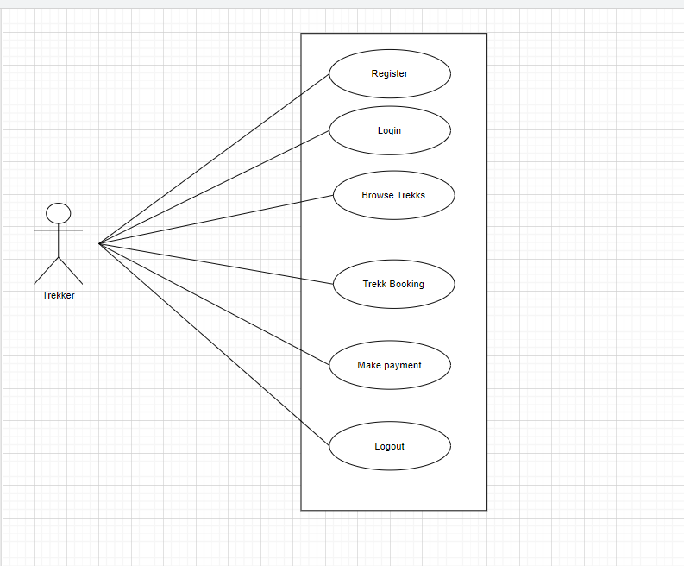
Trekker:
Trekker can register and create his own account.
Sahyadri Navigator provides the function which allows Trekker to find out the information about Trekking Clubs and upcoming trekk
Trekker can Book the trekks and check the booked trekks.
Trekker can view the profile and edit profile.

Slide 8
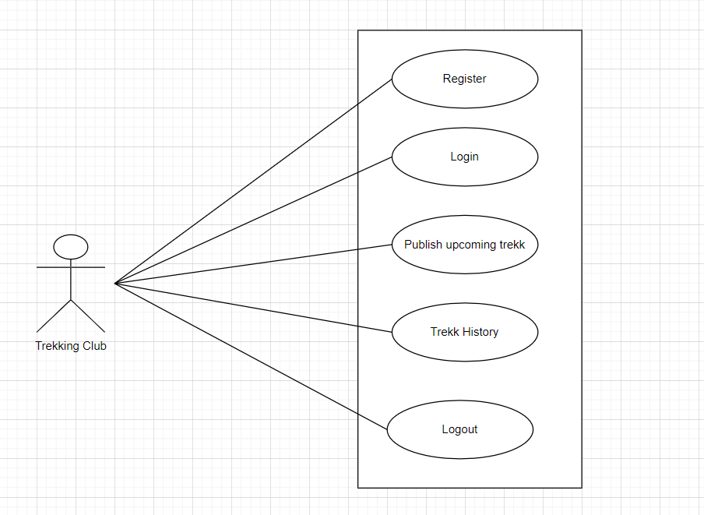
Trekking Club:
Trekking Club can register and create his own account.
Sahyadri Navigator provides the function which allows Trekking Club to Add the trekks and publish his upcoming trekks.
Trekking Club can check the History that which trekker registerd for which trekk and his details.

Slide 9
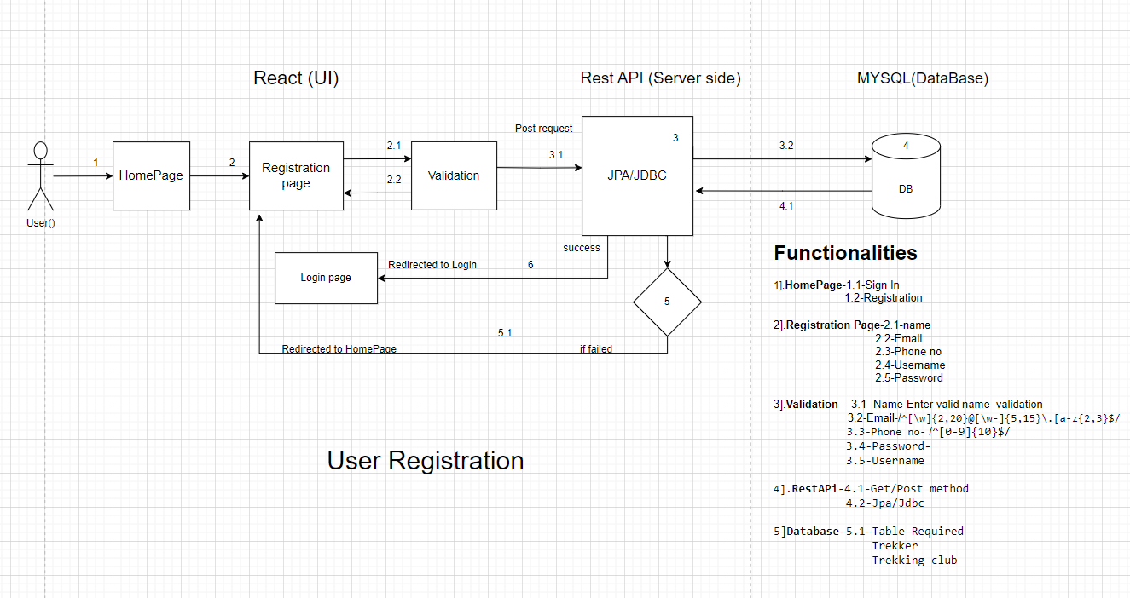
Registration:

Slide 10
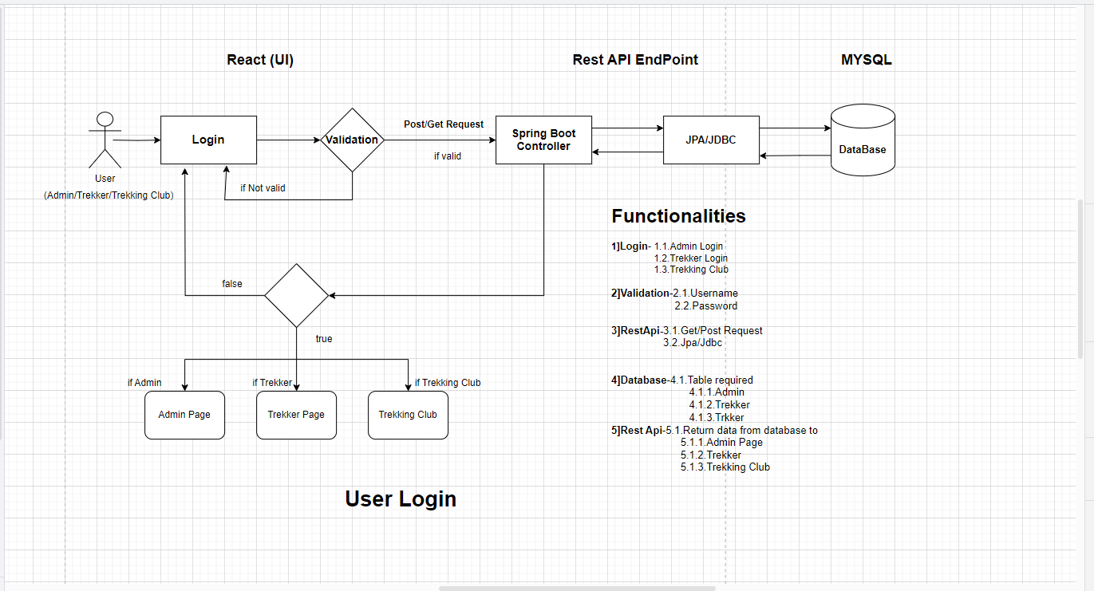
Login Workflow:

Slide 11
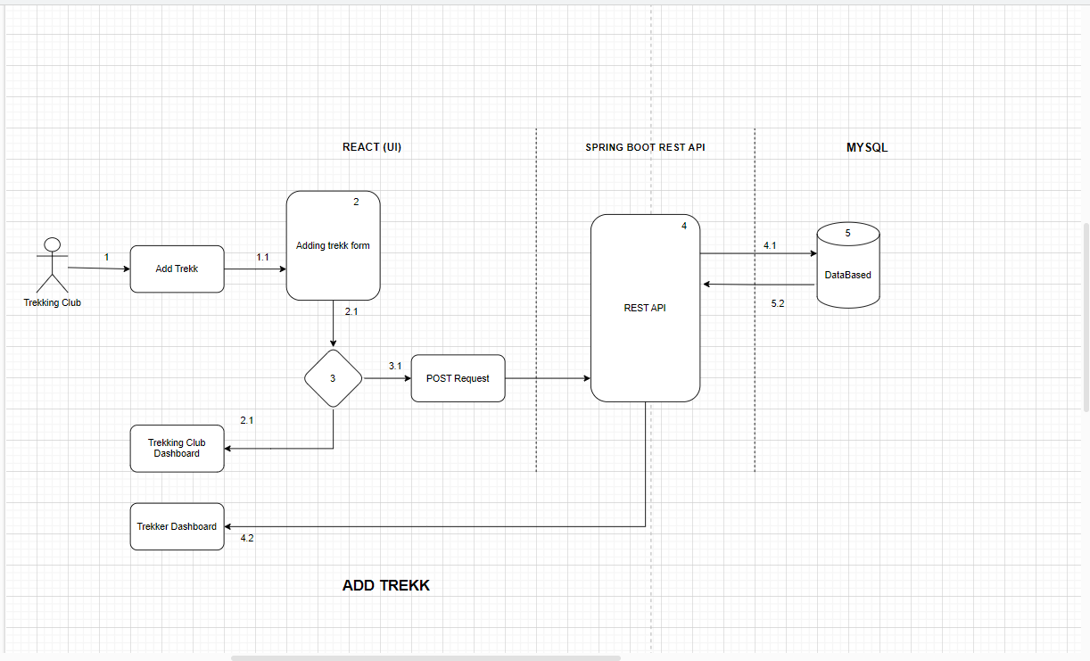
Add Trekk:

Slide 12
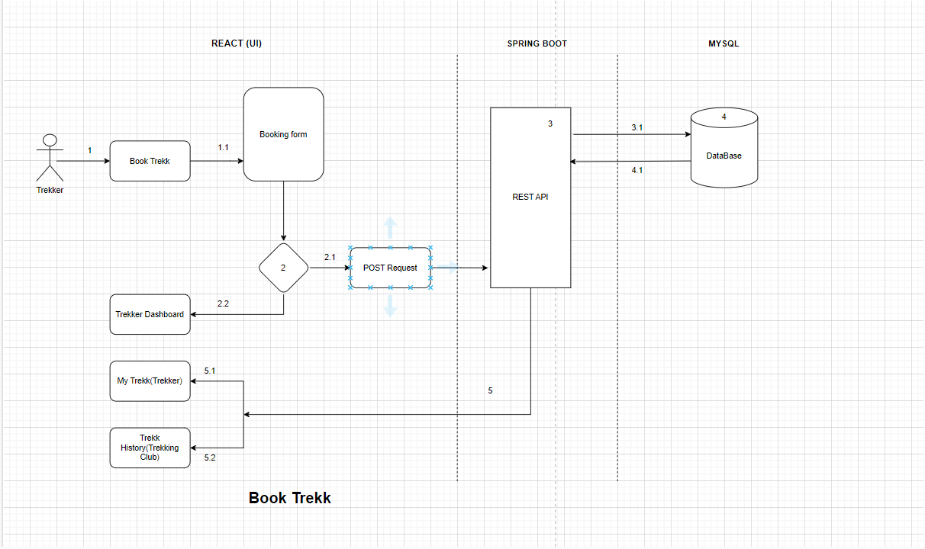
Book Trekk:

Slide 13
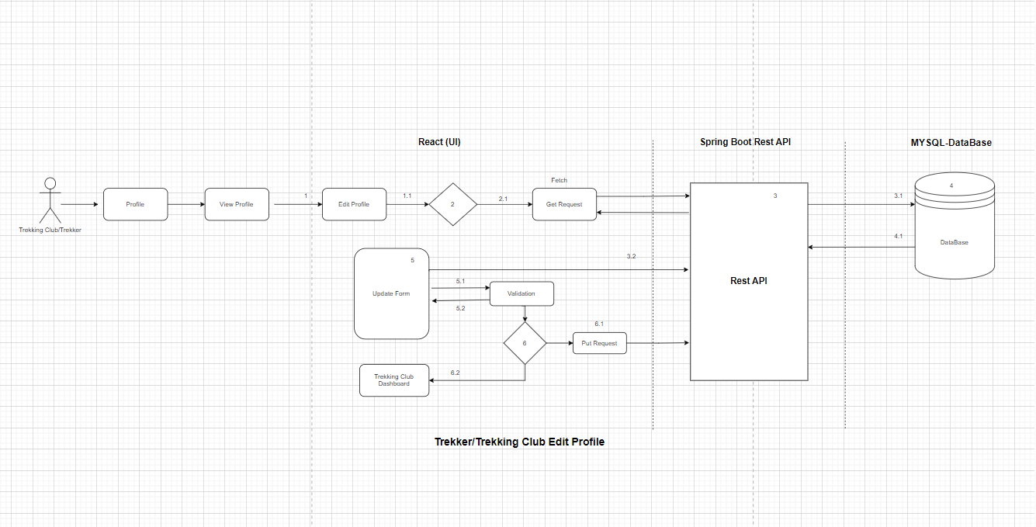
Edit profile:

Slide 14
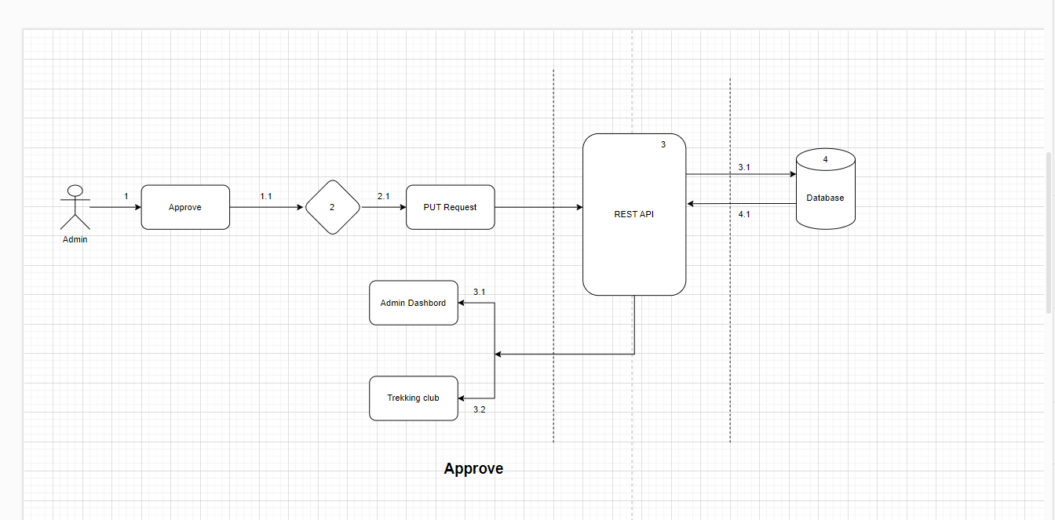
Approve :

Slide 15
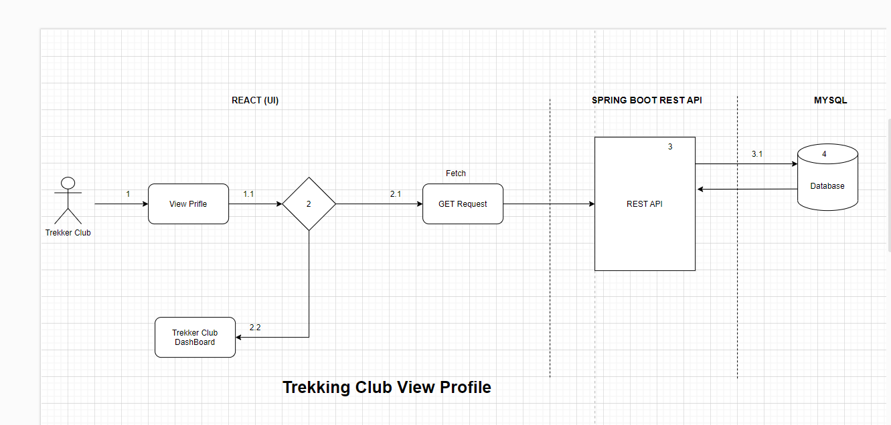
View Profile:

Slide 16
Testing APPROACH:
​REST API using Postman

Slide 17
Future extensions:
1.Payment Transaction
2.Enquiry through email for trekkers.
3.Trekking Club view list of email and give response according to query.
4.Trekker can view and download transaction ricept.

Slide 18
Thank You……….

